Slide 1
Learning Artifacts
974 CGPS

Slide 2
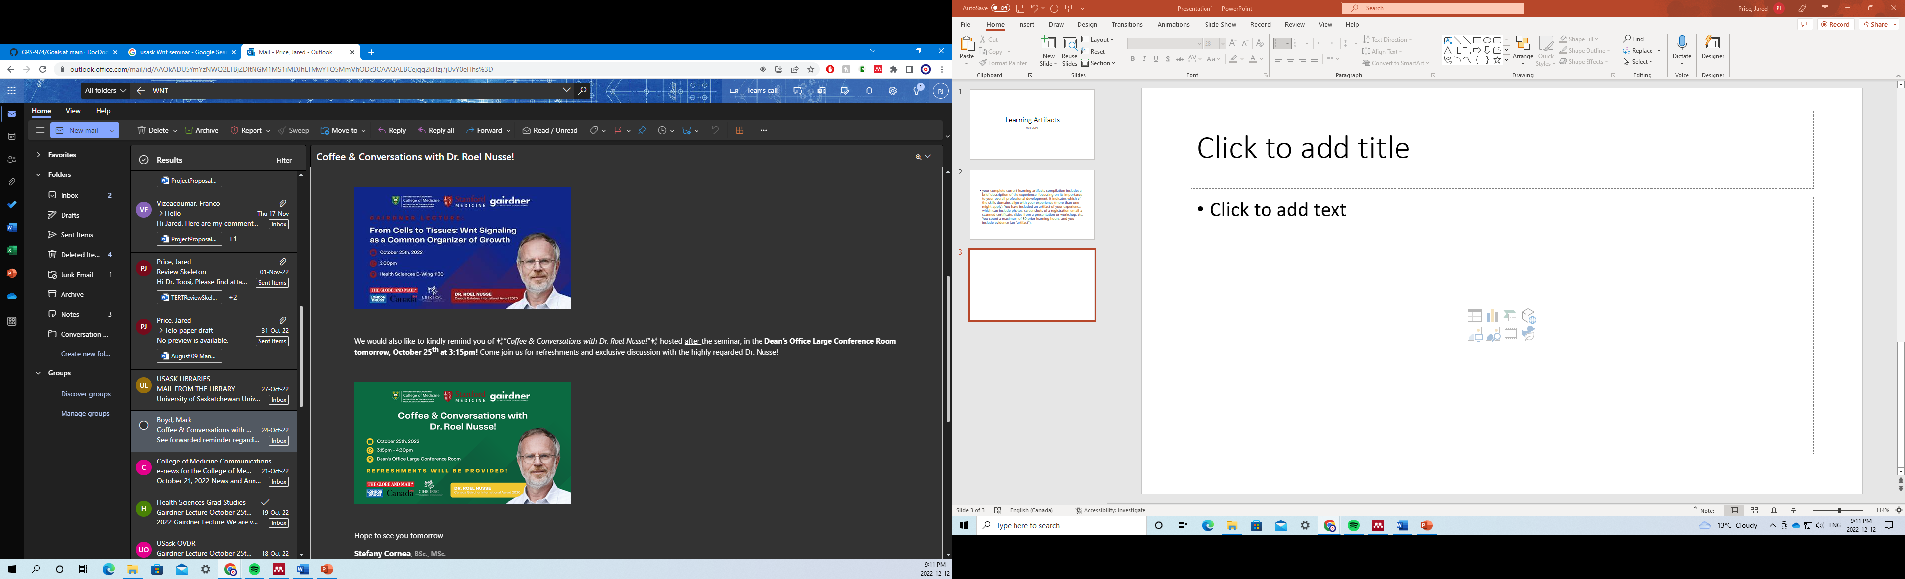
Dr. Roel Nusse is a highly esteemed researcher from Stanford who was recently awarded the prestigious Gairdner International Award in 2020. As part of this award’s tenure, the recipient goes on a tour of the nation to present their research. I attended this lecture and the subsequent coffee afterwards. I consider this an important artifact as I normally would be hesitant to engage in a social setting such as this, especially considering Dr. Nusse’s reputation. Despite myself, I attended this and got to speak with him and ask him questions regarding my own research. I considered this an excellent learning opportunity for my own academic development due to the perspective I could engage in. (Interpersonal skills, career development)

Slide 3
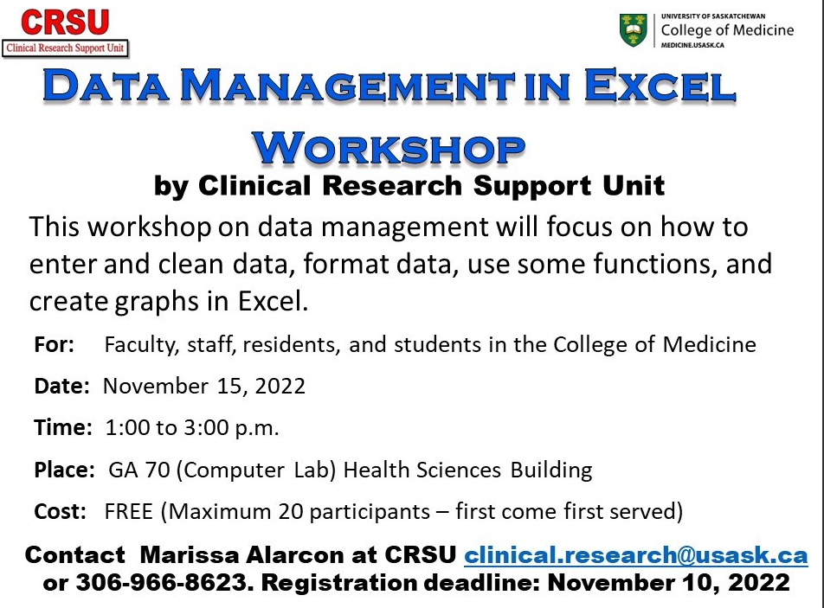
This was a workshop to improve on my excel skills. I consider this important for professional development as it taught me skills which will ultimately make me more efficient and save time, but also in the immense value excel has in data management. Being more competent in Excel makes me a more competent professional. (Research and Project Management)

Slide 4
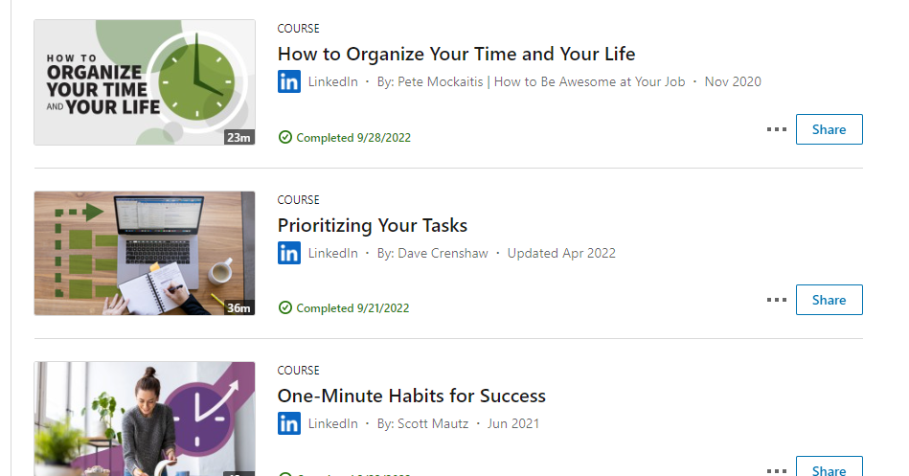
I engaged in these independent learning activities to learn time management skills. They taught novel frameworks for organizing workflow to limit the number of distractions. This information was useful in helping me be more efficient and hopefully manage my time a bit better. (Intrapersonal skills, life balance)

Slide 5
Oct 3 /22
This marks the first passage I’ve written on the subject of being a graduate student. Its been about four months since I’ve started this project and in a scary way
that means I only have 32 months left and by that I mean I only have 28 months left. Time has flown by faster than I can imagine and I feel caught between the world
of doing too little and doing too much. It is probably better summed by having too few results and too little time in the day. I’ve learned a lot in my brief tenure,
plenty of scientific skills that I wouldn’t have thought available, hell, I learned how to anesthetize a mouse. I know I’m going to have to increase my commitment to
the this project, and that means learning how to better manage my time. I think my biggest issue is the loss to nothing. Time spend on social media, time spent resting,
time doing leisurely things. Time needed for balancing my mental state but time that I cannot affort to continue to lose. Marcus Aurelius said something along the lines
of a man’s value can be somewhat measured by the merit of his actions. What does it say of my own merit being occupied with work? Or maybe worse, spending it in leisure
without substantial production. One avenue I’d like to keep is leisure reading. I find it calming and has the potential to improve my vocabulary, something necessary in
this career. I may even gain something along the lines of charisma. I could also try experimenting with time blocks and never violating these rules. Something is going
to have to give if this is going to work out.
Oct 6/22
Three days pass and my mind is occupied with the ideas of network and image. By virtue of my position, I have somewhat a secure platform to base the next five years of
my career from, but what comes next and how can I maneuver to ensure my most likely outcome is also my most beneficial. The current stance is to network and build a
community of people, something I have loathed as an enthusiastic introvert. I think a good first step is improving my linked in and twitter feeds; these seem to be the
most popular in professional circles. My instagram could also be improved with more social aspects. I think the best way to manage this is to set aside one hour a month
or maybe biweekly to update these platforms and ensure they are putting forth my best foot. With thanksgiving this week, I think I am going to plan the remainder of this
week as an opportunity to get my head on straight and then post monday, my nose to the grindstone. I worry how this will impact my personal relationships but I must trust
if I communicate these difficulties, they will be adequately understanding. Oh I got to get to work.
Oct 11/22
The much anticipated respite of the long weekend has done wonders for body and soul as I returned home for Thanksgiving. We've had so much to do and perhaps foolishly
enough, I did very little this weekend. I feel rested. Hopeful. That in itself validates the rest in that it may fuel my continued efforts for the foreseeable future. I
took a page from the presentation last week on networks and orienting yourself with your strengths and have worked on my virtual portfolio. I've reexamined my Linkedin
and have started a Twitter page and have scheduled a weekly time on Friday to manage them. Research is going well, I've scaled up efforts to do mass transfections of my
osteosarcomas and my HT1080 parental and hTERT overexpression lines. In the immediate future I will process these into clonogenicity, resazurin, fluoresence, and
validation through qPCR on the knockdowns. I can report with some satisfaction that the knockdown is limiting mitochondria potentiation, although I will need a more robust
technique to validate this. Phenix project remains stalled with the limitation on microscopy facilities though I have my experiment planned. Though the weather worsens
with each passing day, I report that my own spirits remain undisturbed and zealous for tomorrow. Epictetus says, 'Don't explain your philosphy, embody it'. I think the
simplicity of the Stoics in their mantra is worth pursuing. An enlightenment that requires complex teaching and doctrine must fall away from a suitable path in that it
remains inaccessible to the masses. What Stoicism speaks of is simply rationality and viewing the world through an empiric lens. Perfect for a scientist and certainly
available to any person who wishes it. I wonder in what capacity learning of these different perspectives actually impacts my perception of reality or is it moreso in
retrospection.
Oct 16/22
This was a long day and very unrepresentative of what I imagine a weekend to be like. I had the pleasure of baking today, cinnamon buns, delicious as promised by my
imagination and surely a welcome sight for lab tomorrow. Despite this small victory, I find myself rather muted from the work this weekend. 15 hours of lab work alone.
This cannot be sustainable, especially with dry work and anything else I may want to accomplish. I try not to be frustrated or upset. Try to look at it in the Stoic
lens of it is simply a part of the human experience. As much as the setting sun is part of the normal day, working a weekend here and there, however disappointing is
nothing more than part of what it means to be a person. One should not find frustration in more positive parts of life, and so should try to not be overwhelmed when
more negative things rear their face. If nothing else, it was wholly productive and hopefully I will reap these results this coming week. I can note that for the first
time in many years I finished reading a book of fiction for my own enjoyment. As recommended by my partner, 'A Court of Roses and Thorns' was enjoyable to read, a bit
~particular~ at some points, but overly pleasant. It served as a gentle reminder to seek balance in my life. At this time my career and academics have dominated most
of my time. I've tried to make time for physical health with some modest success but creative outlets have been sorely overlooked. I've got some changes to make.
Oct 18/22
Today was a milestone day in that I finished the first stage of imaging my knockdowns for the Neverland project. Exciting in that I can go a few days without peering
down a microscope and that I can finally see if this project is going anywhere or needs to be binned. Not exciting because its time to do stats and image analysis on
some 700 images, each with tens of cells, each with different contexts. It is going to be large effort but I'll see if I can rope my colleagues into helping me. Lately,
mental health has been good. I chalk this up to getting good sleep and plenty of exercise given that the workload is anything but peaceful. Truly humble, I've realized
I know far too little about almost everything so I spent some time in the library and checked out some resources to bolster my knowledge base. It's reminiscent of
undergraduate with the relearning of the biochemistry and genetics at play but I think it will be beneficial for me. I've been listening to a podcast called 'Fall
of Civilizations' cataloging the details of the rise and fall of the many civilizations around the world, from Inca to Assyrian, from Han Chinese to Greenland Vikings.
It has greatly changed my perception of society as a whole, just in the day to day. I find myself imaging passerby as they would be a thousand years ago. Some students
passed by talking about the latest football game not unlike some locals of Constantinople discussing the results of the latest chariot races. Or someone complaining
about the carbon tax being wholely similar to a disgruntled lord fuming about excessive taxation by the king. I wonder about my own place in society and our society's
place in the larger historical context. A citizen of a recently liberated province of the once-burgeoning British empire. Although Canada's liberation from British
rule is far less bloody that historically typical, I wonder what we can expect next in the eternal ebb and flow of regional, and as of the last couple hundred years,
global, powers of conquest.
Oct 20/22
Not much to update on, though I have a spare moment to write so I shall. Today was plasmid isolation which is probably my least favourite protocol out there. Yield was
good so hopefully won't have to do that particular plasmid again until after my dissertation. I woke up pretty groggy this morning in stark contrast to yesterday
brimming with energy. I think that one thing on my mind is the purpose of this exercise. Brought on my the weather more likely than not, I wonder what I'm trying to
accomplish through this exercise. To be more reflective. Well to what end. I suppose that is the purpose of the reflection is it not. For our own benefit, does
understanding our motives or own nature lend itself in any way to a quantifiable change in your life. Can it bring me fame and riches? Will it make me happier? Or is
it simply for knowledge sake? For me, I find it mellows out most experiences in the moment and in retrospection which may have benefit in challening stressful moments
or in making decisions with this knowledge at my foundation. Maybe in some way by understanding myself I can make decisions that in my best interest. If done correctly
it may limit the value of future reflection although any deviation from expected benefit would be substantial grounds to adjust the reflection process for better
outcomes.
Oct 26/22
The marvel of technology strikes yet again as I pass the burden of mundane work unto the computer. I was previously tasked with phenotyping tens of thousands and
quantifying membrane potential by hand but have been instructed to instead train an artificial intelligence to do it instead. Far cooler and far more time friendly.
This week has seen many tasks been assigned in the world of writing. My research advisory committee has finally been selected and with that the urgent need to prepare my
project proposal for my research. In addition, my cosupervisor has been invited to produce a review for a journal and indicated I shall lead these efforts. Today I
submitted the first draft of our plan to the group for review before I begin the drafting process. The transition to winter from fall seems to have happened overnight.
Sunday felt like dawn by 7am, Monday, the sun barely cleared the horizon by 8:30am. Some hyperbole but the point stands. I seem to be less tolerant of the cold with
each passing year. I'm looking forward to an early night with hopefully no shortage of sleep.
Oct 28/22
I wonder what lies ahead in these next days and weeks and months. I'm settling into a routine of wake, research, leisure, sleep. It seems to be holding steady as
I find that the normal tug of mental challenges seem weaker this year. I must seem repetitive but I find myself struggling with the nature of this work. From undergrad
and medicine where each hour, waking and not, was accounted for. Especially in medicine, where the slightest deviation resulted in a hasty email reminding me that
aforementioned deviation was a breach of professionalism and would not be well tolerated if continued. Here, I am my own ruler, my kingdom: my timetable. I find it
difficult to work without the looming deadlines. Now they lie months if not years in the future and it is limited in its motivation. I'm still trying to decide what
will be the fuel that I burn. Sparks come and go, but I need something enduring that will wake me in the early hours and power me through the late. I've tried to
turning to Stoicism to mixed benefit but there needs to be something more. I find philosophy beneficial, probably not unlike many find solace in meditation or
medication. Something better must come.
Oct 31/22
Today I was priviledged to partake in the tumor harvest of a colleague's mouse experiment. Nearly a month ago, millions of cells were injected into mice to evaluate an
antitumor therapy and today is the day we evaluate its effect. It was a pleasant experience beyond its rather grotesque nature. It reminded me of surgery in medicine
as I mentally noted the similarities and dissimilarities of the anatomy between mouse and man. In particular, I found it most interesting how the different layers of
fascia may be removed rather seamlessly from one another and in the same light, contain the tumor between them; without gross spread to adjacent layers. Last night I
was again invited to play recreational water polo with the vet girls, an odd specification as the vast majority of their department is female. For this reason, I was
a necessary sub as the league is co-ed. It was good fun and exercise and reminded me of learning to swim as a child. I can barely remember the last time I took lessons
nor when I swam for leisure. I think it would be something I would enjoy to do again in the future.
Nov 3/22
Better late than never I say to myself in most things and especially in regards to my project proposal. There is talk about my first committee meeting happening soon
and with that the requirement to produce a lengthy project proposal to convince of the legitimacy and merit of my project. As my dual degree projection is a mere three
years of tenure, I have scarcely 31 months left to have everything complete and the dissertation defended so realistically it is closer to 28 or so for the actual
research. That is terrifying to think about at best. I have some strengths, namely wonderful images via the confocal microscope and a wonderful bioinformatician to make
sense of their bulk. Additionally a suite of colony forming assays with verification of knockdown via qPCR or Western. Additionally, I may include some data from some
of the other projects such as the LG dye project or the Terra project. There is therapy in taking that first step, that small rush of Dopamine for being productive.
This has been a good week.
Nov 8/22
It is election season down in the land of the free and the topic on everyone's mind is what is going to happen. It seems like President Biden has earned himself a low
approval rating, the lowest in recent memory and the expectation is that the Republican candidates will sweep these senate races. I wonder where things will go. As an
onlooker from a foreign country, my thoughts go to how their outcomes will affect my life here. I think to 'We didn't start the fire' and the legitimacy of the claim
that the world has always been in crisis. Maybe it has been. Maybe its a coincidence of my adult life starting with the onset of a global pandemic.
Nov 12/22
Friday is finally arrived and with it the promise of rest. Allegedly. I finally did some math on this whole grad school thing which hopefully is correct before
immortalizing it here. Hypothetically, a PhD student with the intention of graduating in 5 years works 40 hours a week to complete this goal. Then at a minimum I need
to log about 64ish hours a week to make it in 3 years for this program. Thats just 13 hours a day Monday through Friday. Now, how about the students who work more than
8 hours a day on their programs. We are in serious trouble in this is where we are headed. I understand that I'm young and if there ever was a time to work hard it is
now but damn. I'm struggling between balancing lab time and writing time in a given day. I am so exhausted by the end I have no will to write so something is going to
have to give. I suspect it will be the lab work.
Nov 15/22
In hindsight, I could afford to be more conscientious. I was analyzing my clonogenics, those horrible experiments, and found so much variation. I think the shotgun
approach which works so well in so many contexts falls short here. I think it calls for a more methodical approach of cell line by cell line, grow, test, validate,
repeat, and finally move on to another. I know the committee will not be super keen on these, but at least there is a plan to fix those up. I've made great progress
in writing these last couple days, nearly 5000 words which I don't think anyone wants to read. haha. Anyways, that's a considerable weight off my shoulders and now
to work on the small details and prepare for the TERRA project set. Also I should do some Lyso work before the holidays.
Nov 22/2
Well I super forgot to add artifacts to my repository but will hop to that soon. I should also schedule a meeting with a resume expert of sorts to make sure the ol'CV
is in good order. I am so excited for this month to be over. Everyone on my team is putting in the extra hours so that December can be peaceful and quiet. I look
forward to taking off a couple weeks around the holidays to recover and prepare for a productive 2023. Maybe that says something about looking too much to the future
and not enough the past if its only November and I'm thinking about my resolutions for the new year.
Nov 30/22
The day of the committee meeting has arrived and I have finished it. I was pleasantly surprised by how it went. The members
were all very nice and seemed interested in the project. Furthermore, they were reasonable in their questions, maybe
indicating I did an adequate job of explaining the project. Regardless, I am approved to continue research, at least until
the next meeting. This is a wonderful weight off my chest and now I can continue my work on the other projects.
Dec 2/22
I arrived in Regina late tonight, fortunate the roads were nice. I'm looking forward to spending tomorrow evening with my
dear friends for agribition. I don't think I attended for nearly a decade or longer. It's been nearly a year since I've seen
them and months since I've taken a night on the town so to say. It is bitterly cold as of late and I do not look forward to
walking to work on Monday as I sit here in my childhood home. Ah to think in a mere 2 weeks, vacation.
This artifact is representative of the journal entries I made as one of my goals in 974 (intrapersonal skills, wellness)

Slide 6
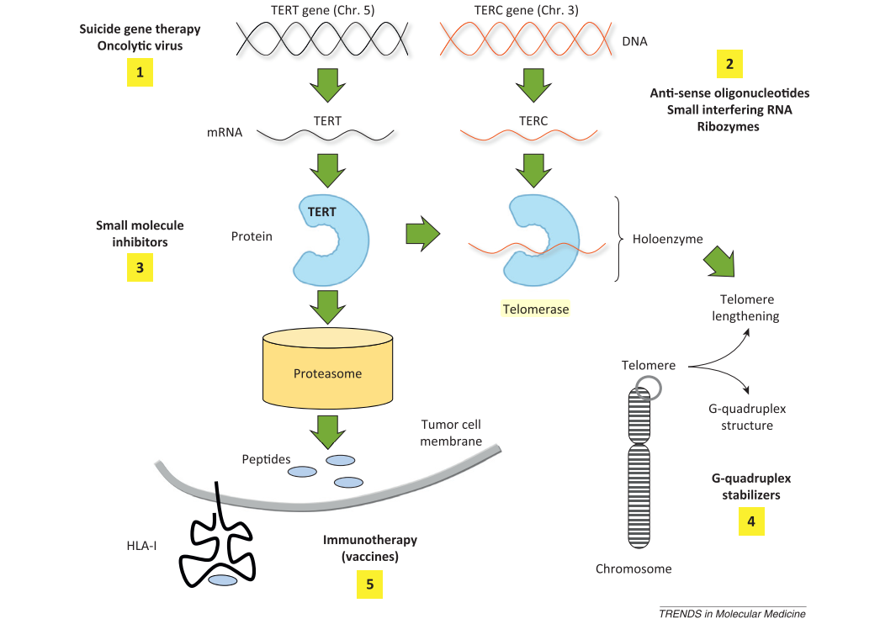
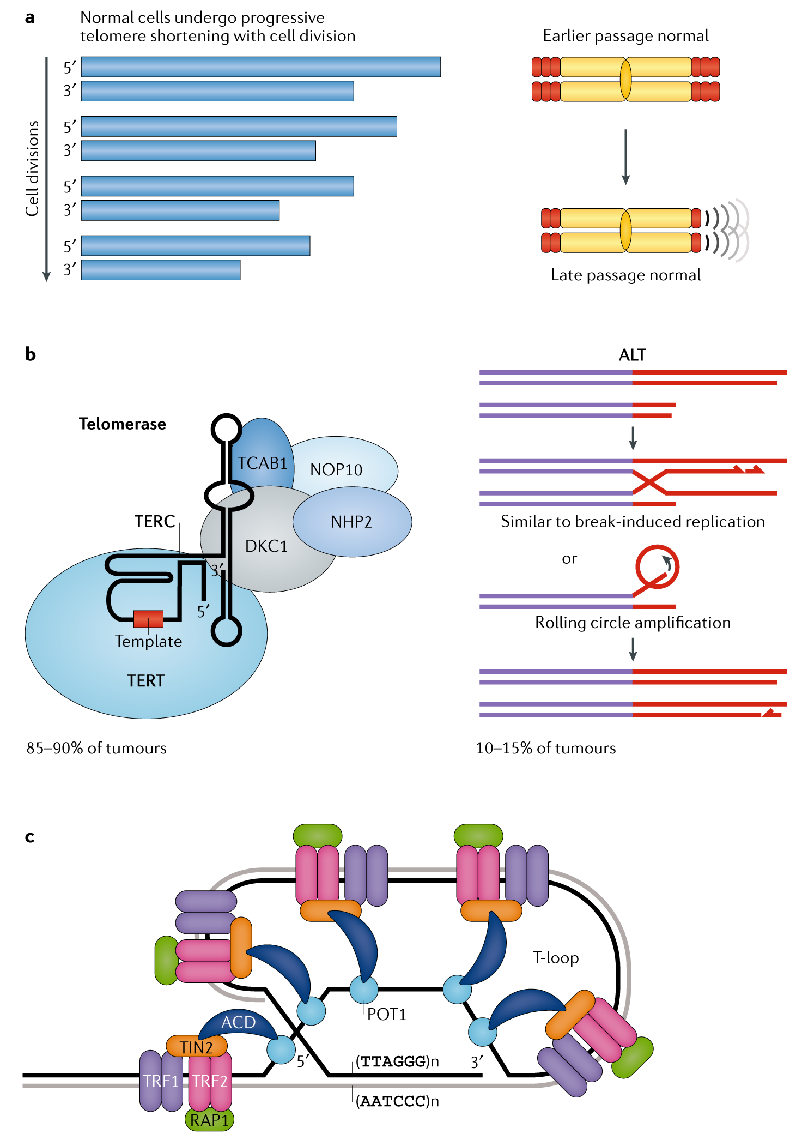
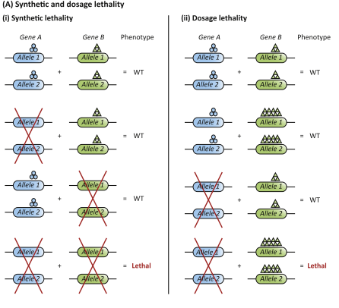
Some graphics from key literature in my review article. (Career development, research and project management)
Shay JW, Wright WE. Telomeres and telomerase: three decades of progress. Nat Rev Genet [Internet]. 2019;20(5):299–309. Available from: http://dx.doi.org/10.1038/s41576-019-0099-1
Mocellin S, Pooley KA, Nitti D. Telomerase and the search for the end of cancer. Trends Mol Med [Internet]. 2013;19(2):125–33. Available from: http://dx.doi.org/10.1016/j.molmed.2012.11.006
Paul JM, Templeton SD, Baharani A, Freywald A, Vizeacoumar FJ. Building high-resolution synthetic lethal networks: A “Google map” of the cancer cell. Trends Mol Med [Internet]. 2014;20(12):704–15. Available from: http://dx.doi.org/10.1016/j.molmed.2014.09.009

Slide 7
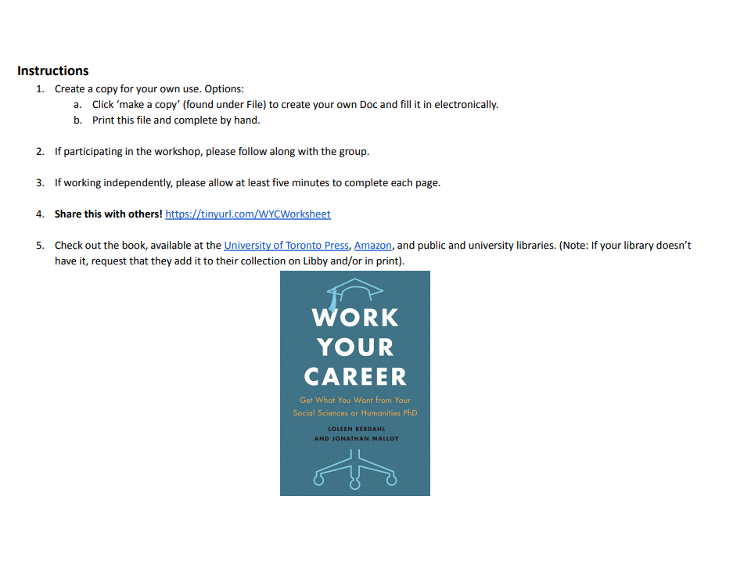
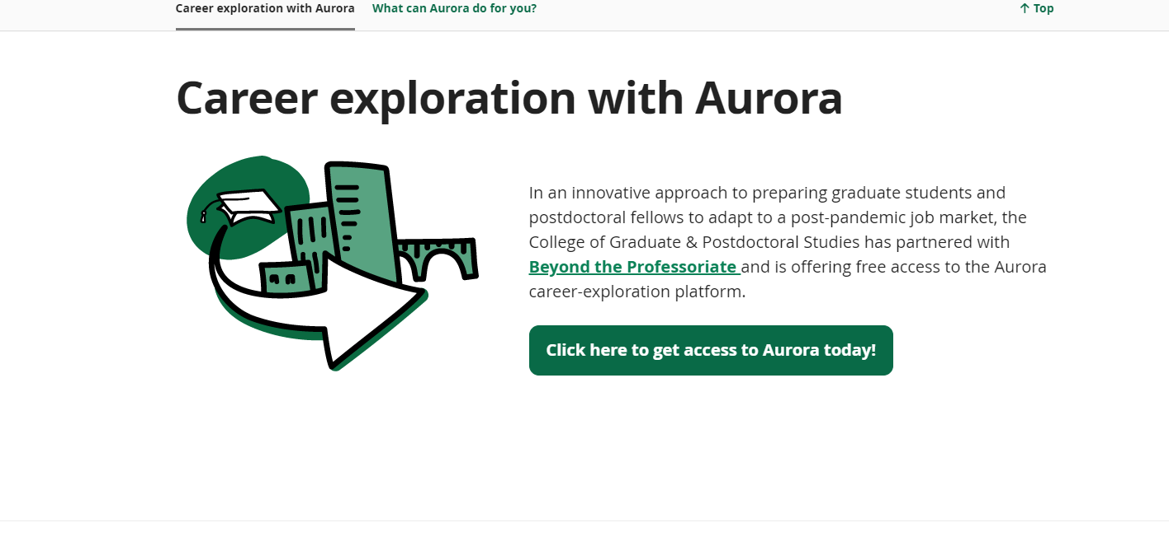
Professional Development Workshop. Learned about different resources for networking at usask and abroad. Also taught techniques for connecting different skills to personal stories. (Professionalism, interpersonal skills, communication, career development)

Slide 8
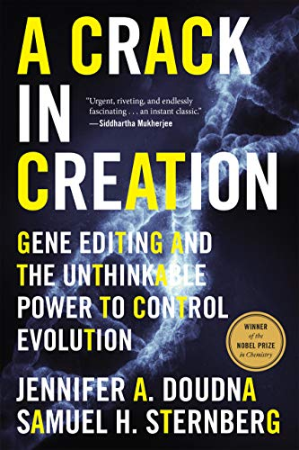
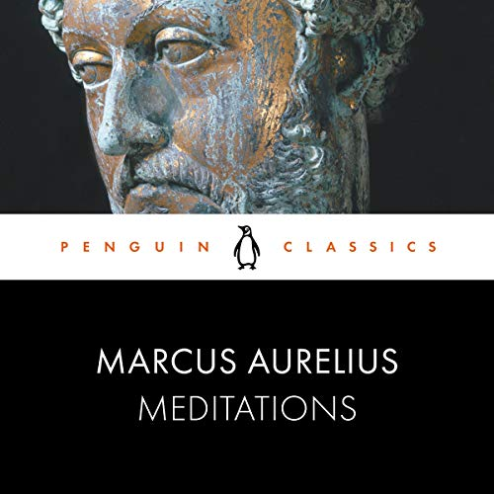
These are the two resources I consulted as a learning coaches. I was unsuccessful in making a connection with a person I wanted to so chose to get coaching from literary sources. I found Meditations as an excellent primary source for Stoic philosophy, a framework I thought about integrating into my life. A Crack in Creation is a tale recounting Dr. Doudna’s discovery of CRISPRcas9 and the years that followed it. She is a remarkable individual and I consider many parts of her career desirable as I start my own. Both of these works were interesting to me to change my outlook on life and to encourage me to make decisions that are best for my professional development. (Leadership, intrapersonal skills, career development, wellness)

